Slide 1
Project scheduling

Slide 2
Project Scheduling
Excessive or irrational schedules are probably the single most destructive influence in all of software.
Software project scheduling is an action that distributes estimated effort across the planned project duration by allocating the effort to specific software engineering tasks.
Scheduling for software engineering projects can be viewed from two different perspectives.
In the first, an end date for release of a computer-based system has already (and irrevocably) been established. The software organization is constrained to distribute effort within the prescribed time frame.
The second view of software scheduling assumes that rough chronological bounds have been discussed but that the end date is set by the software engineering organization. Effort is distributed to make best use of resources, and an end date is defined after careful analysis of the software.

Slide 3
basic principles of software project scheduling
Compartmentalization
Interdependency
Time allocation
Effort validation
Defined responsibilities
Defined outcomes
Defined milestones

Slide 4
basic principles of software project scheduling
Compartmentalization:-> split into number of manageable activities and tasks.
Accomplished by refining both the product and the process
Interdependency: -> interdependency of each compartmentalized activity or task must be determined.
Tasks occur in sequence or in parallel. Some activities cannot commence until the work product produced by another is available. Other activities can occur independently.
Time allocation:-> each task to be scheduled must be allocated some number of work units (e.g, Person-days of effort).
Each task must be assigned a start date and a completion date that are a function of the interdependencies and whether work will be conducted on a full-time or part-time basis.
Effort validation: at time allocation-> ensure that no more than the allocated number of people has been scheduled at any given time.
Defined responsibilities -> every task that is scheduled should be assigned to a specific team member.
Defined outcomes:-> every task that is scheduled should have a defined outcome.
Defined milestones:-> every task or group of tasks should be associated with a project milestone. A milestone is accomplished when one or more work products has been reviewed for quality and has been approve

Slide 5
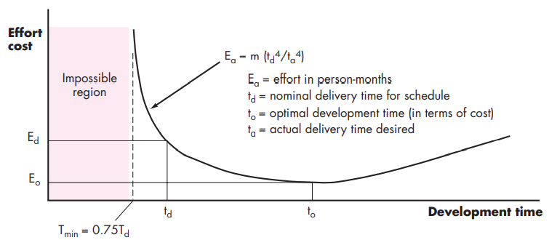
People and Effort

Slide 6
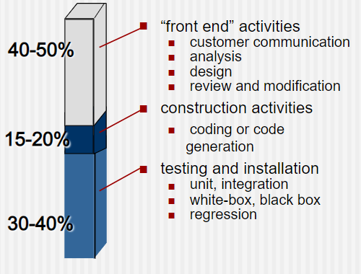
Effort distribution

Slide 7
Defining Task Sets
An adaptable process model (APM) has been developed to assist in defining task sets for various software projects
Determine the type of project
Assess the degree of rigor required
Identify adaptation criteria
Select appropriate software engineering tasks

Slide 8
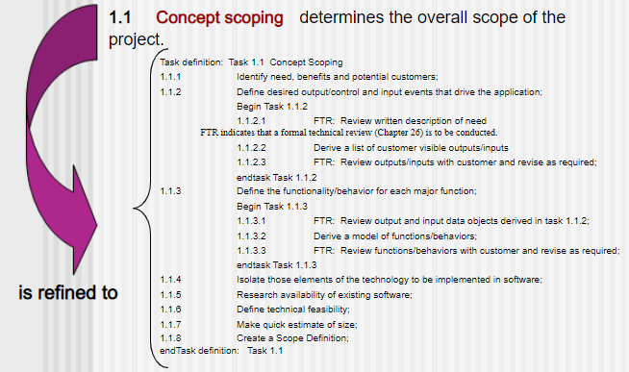
Task set Refinement

Slide 9
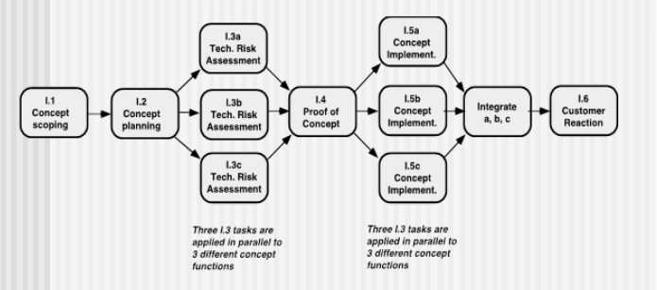
Define a Task Network
A task network, also called an activity network, is a graphic representation of the task flow for a project.
The task network is a useful mechanism for depicting intertask dependencies and determining the critical path

Slide 10
Scheduling
Program evaluation and review technique (PERT) and the critical path method (CPM) are two project scheduling methods that can be applied to software development.
Driven by information already developed in earlier project planning activities: estimates of effort, a decomposition of the product function, the selection of the appropriate process model and task set, and decomposition of the tasks that are selected
Both PERT and CPM provide quantitative tools that allow you to
(1) determine the critical path—the chain of tasks that determines the duration of the project,
(2) establish “most likely” time estimates for individual tasks by applying statistical models, and (3) calculate “boundary times” that define a time “window” for a particular task

Slide 11
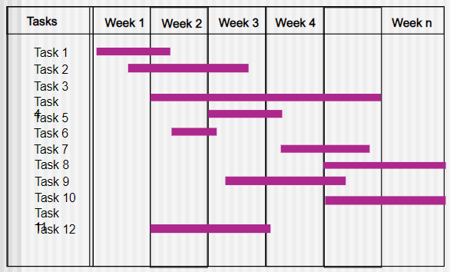
Timeline Charts – Gantt Chart
A time-line chart can be developed for the entire project. Alternatively, separate charts can be developed for each project function or for each individual working on the project.

Slide 12
Schedule Tracking
Conduct periodic project status meetings in which each team member reports progress and problems.
Evaluate the results of all reviews conducted throughout the software engineering process.
Determine whether formal project milestones have been accomplished by the scheduled date.
Compare the actual start-date to the planned start-date for each project task listed in the resource table.
Meet informally with practitioners to obtain their subjective assessment of progress to date and problems on the horizon.
Use earned value analysis to assess progress quantitatively.

Slide 13
Earned value Analysis
Earned value provides a quantitative indication of progress
Enables us to assess the “percent of completeness” of a project using quantitative analysis rather than rely on a gut feeling“
Provides accurate and reliable readings of performance from as early as 15 percent into the project

Slide 14
Computing Earned Value
The budgeted cost of work scheduled (BCWS) is determined for each work task represented in the schedule.
BCWS_{i} is the effort planned for work task i.
To determine progress at a given point along the project schedule, the value of BCWS is the sum of the BCWS_{i} values for all work tasks that should have been completed by that point in time on the project schedule.
The BCWS values for all work tasks are summed to derive the budget at completion, BAC. Hence, BAC = ∑ (BCWS_{k}) for all tasks k.

Slide 15
Computing Earned Value
Next, the value for the budgeted cost of work performed (BCWP) is computed.
The value for BCWP is the sum of the BCWS values for all work tasks that have actually been completed by a point in time on the project schedule.
“The distinction between the BCWS and the BCWP is that the former represents the budget of the activities that were planned to be completed and the latter represents the budget of the activities that actually were completed.”
Given values for BCWS, BAC, and BCWP, important progress indicators can be computed:
Schedule performance index, SPI = BCWP/BCWS
Schedule variance, SV = BCWP – BCWS
SPI is an indication of the efficiency with which the project is utilizing scheduled resources.

Slide 16
Computing Earned Value
Percent scheduled for completion = BCWS/BAC
Provides an indication of the percentage of work that should have been completed by time t.
Percent complete = BCWP/BAC
Provides a quantitative indication of the percent of completeness of the project at a given point in time, t.
Actual cost of work performed, ACWP, is the sum of the effort actually expended on work tasks that have been completed by a point in time on the project schedule.
It is then possible to compute
Cost performance index, CPI = BCWP/ACWP
Cost variance, CV = BCWP – ACWP
CPI -> 1, indicates the project is within its defined budget.

Slide 17
Summary
Scheduling is the culmination of a planning activity that is a primary component of software project management.
When combined with estimation methods and risk analysis, scheduling establishes a road map for the project manager.
Scheduling begins with process decomposition.
The characteristics of the project are used to adapt an appropriate task set for the work to be done.
A task network depicts each engineering task, its dependency on other tasks, and its projected duration.
The task network is used to compute the critical path, a time-line chart, and a variety of project information.
Using the schedule as a guide, you can track and control each step in the software process.

